Slide 1

ML Demo - Customer Churn
“Infinite possibilities with Technology”

Slide 2

01
Identification of data source
02
Data cleaning & pre-processing
Table of
Contents
03
Model Training
04
Output Analysis
Prediction
05

Slide 3
Identification of data source
Data cleaning & pre-processing
Model Training
Output Analysis
Prediction
To predict customer churn in the telecom industry, we utilized a comprehensive dataset:
The dataset was originally split into two dataset in an original 80/20 split. Together the dataset contains over 3 thousand rows and comes for Kaggle
Below are key details about the dataset and the distinct attributes:
Dataset description:
The dataset contains customer attributes in regards to their geographical location, call history, and payments amounts
Key Features: Total day minutes, Total night calls, Area code, Customer service calls

Slide 4
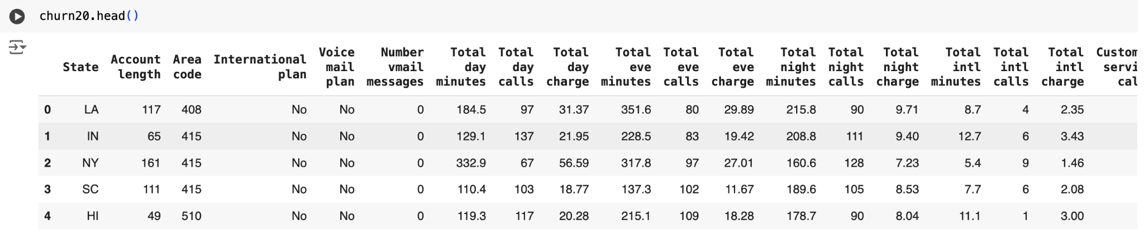
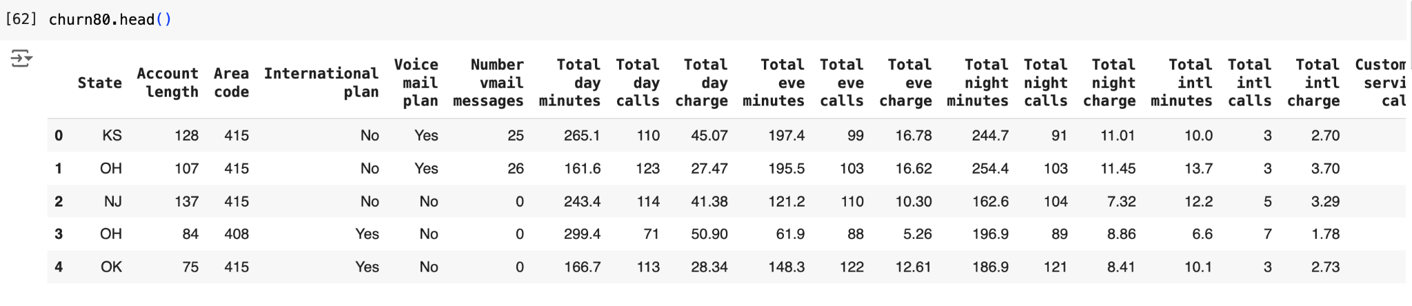
Customer Churn Dataset
Original 20 split data-set
Original 80 split data-set

Slide 5
Identification of data source
Data cleaning & pre-processing
Model Training
Output Analysis
Prediction
Feature Selection - EDA
Correlation Matrix: helped decided which features have high correlation and drop the least important one
Feature Engineering: used a threshold of 0.10 (global standard) to see feature importance
Data Integration: Aggregate, was required to merge data across both sources to create a unified dataset.
Encoding Categorical Variables
Label Encoding:
For binary or ordinal categories (e.g., International Plan and Voice mail Plan: Yes/No), encode with label encoding.

Slide 6
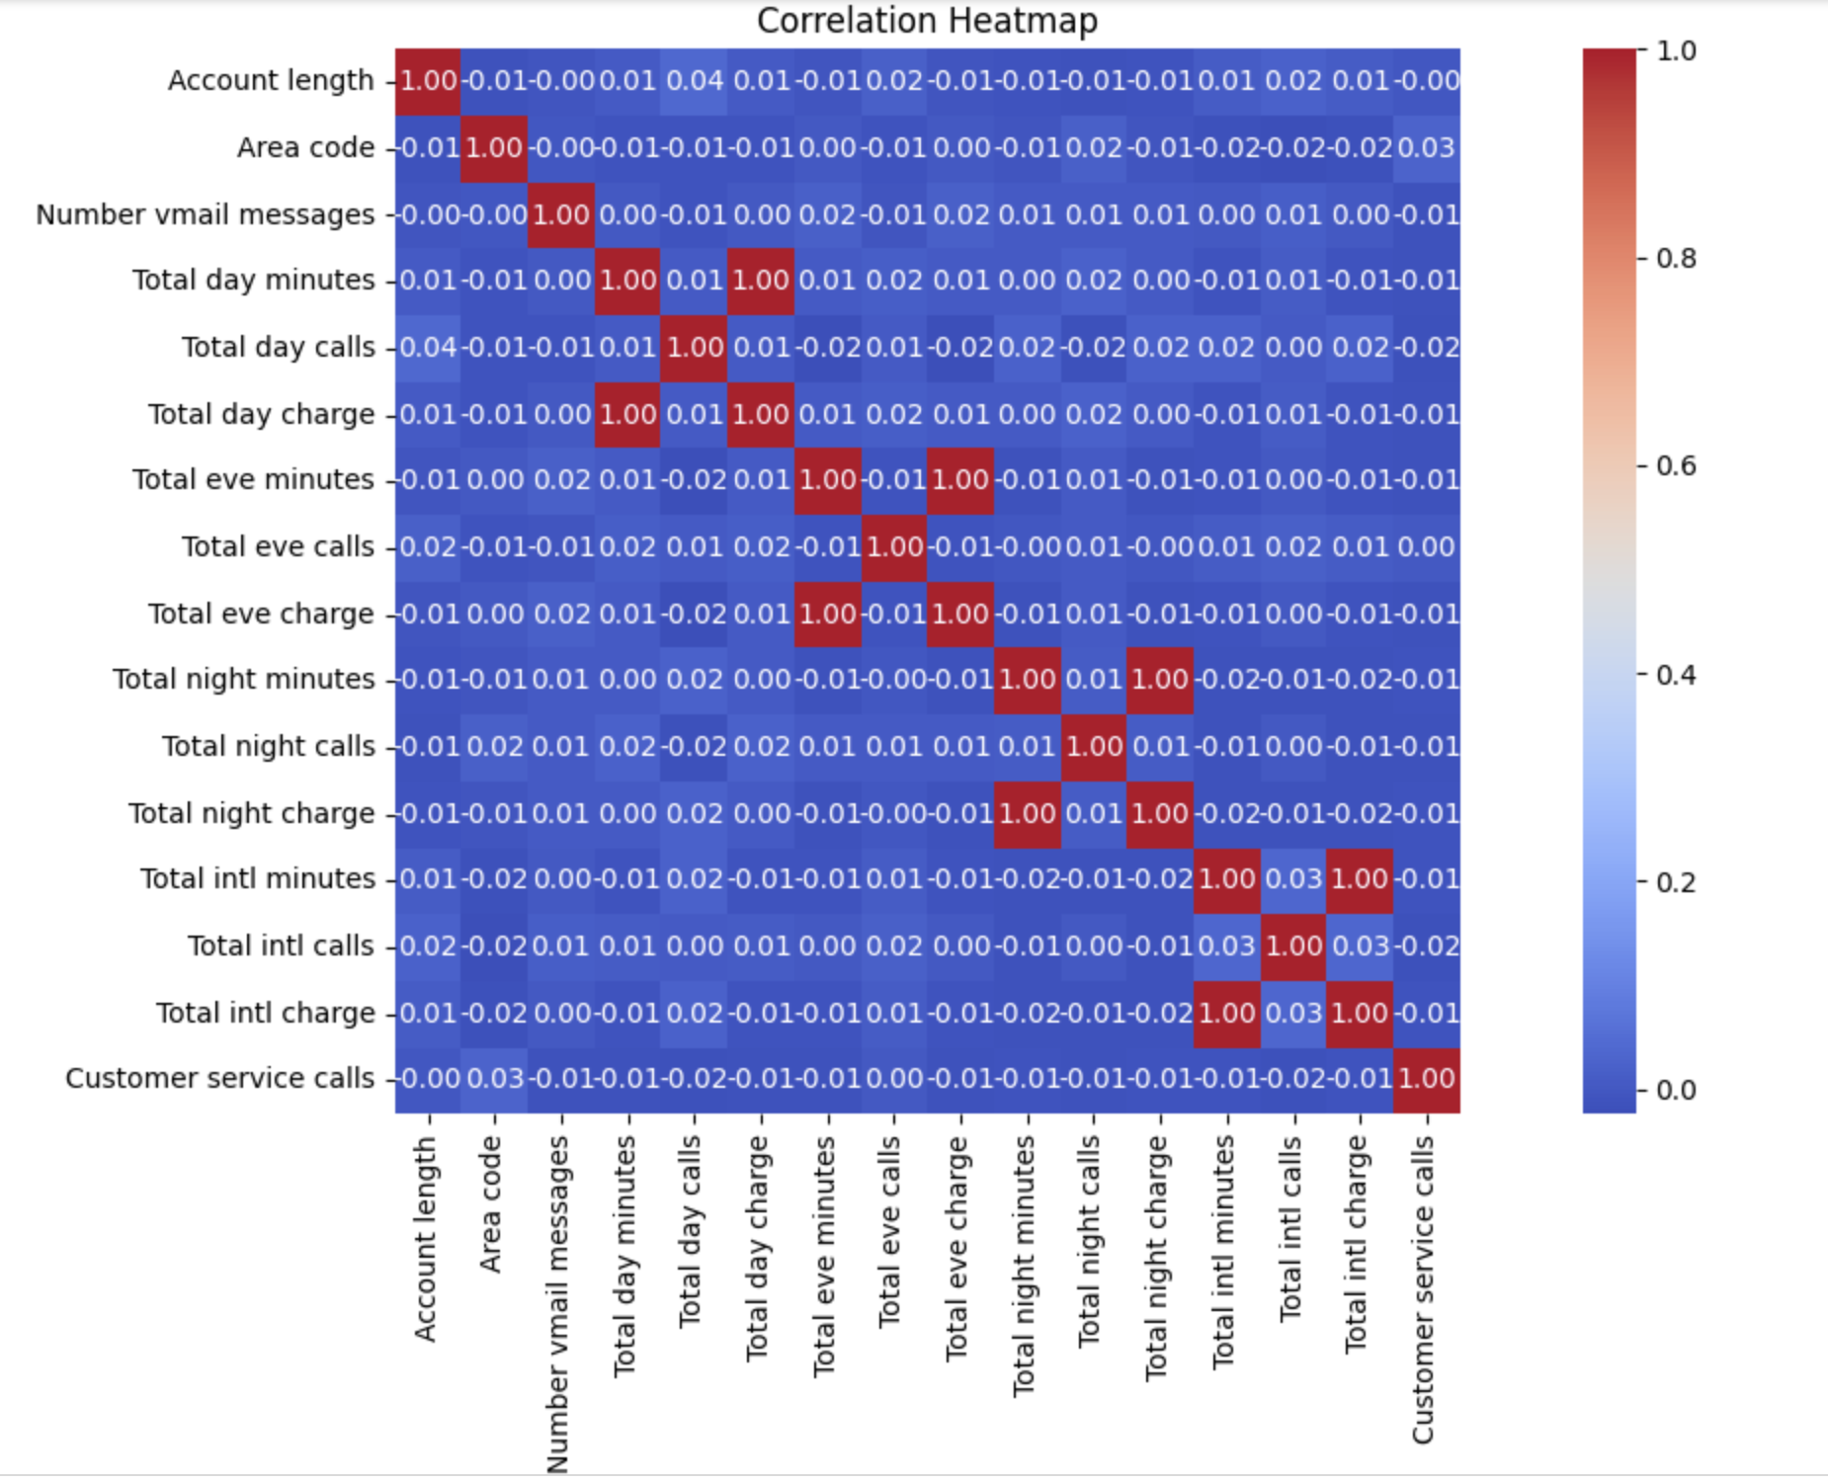
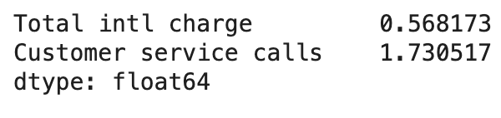
EDA on Merged Data
Correlation Matrix
Feature Engineering on Merged Dataset
Merged Churn Dataset: Below features are dropped as they have strong correlations: 'Total intl charge', 'Total day charge', 'Total eve charge', 'Total night charge'

Slide 7
Data pre-processing (all data set)
Data Cleaning
Missing Values Handling:
Impute missing values with domain-appropriate values (e.g., mean/median for continuous data, most frequent for categorical).
For this data imputed 0.0 instead
Remove Duplicates:
Check for and remove duplicate transactions or customer records to avoid bias and inflated data.
Outlier Detection:
Identify and handle outliers, especially in transaction amounts or high-risk fields. Outliers in fraud detection are tricky: while they can indicate fraud, they can also be legitimate extreme values. So for this case, did not drop any outliers
Data Balancing
Smote a technique is used to help balancing out imbalance data. It was done on the target feature ‘Churn’. It generates synthetic data on the minority values in order to balance the data.
Data Scaling:
Standardize Data
Each feature is scaled and puts into into a balanced scale
Allows for you to makes sure you are analyzing the features on a balanced scale

Slide 8
Identification of data source
Data cleaning & pre-processing
Model Training
Output Analysis
Prediction
To enhance accuracy, and reliability of our customer churn predictability, we have tested accuracy of various ML models with our finalized dataset. Below are the list of models we used for training and testing:
Logistic Regression
Decision Tree
Random Forest
Support Vector Machine
Artificial Neural Network
XGBoost

Slide 9
Identification of data source
Data cleaning & pre-processing
Model Training
Output Analysis
Prediction
 | Test Accuracy | Validation Accuracy | Output Analysis
Logistic Regression | 67.60% | 71.20% | Second to Lowest Accuracy score
Decision Tree | 84.60% | 86.40% | Not as good as other Models
Random Forest | 90.60% | 91.20% | Best performing model
Support Vector Machine | 84.40% | 87.6% | Not as good as other Models
ANN | 85.79% | 88.00% | Decent Score but not as strong as RF
XGBoost | 38.80% | 36.00% | Lowest Accuracy Score
Based on the accuracy of both test data sets and validation data sets, we recommend to use Random Forest. It is the best performing model it is also a stable model as the difference between test and validation accuracy is lowest.

Slide 10
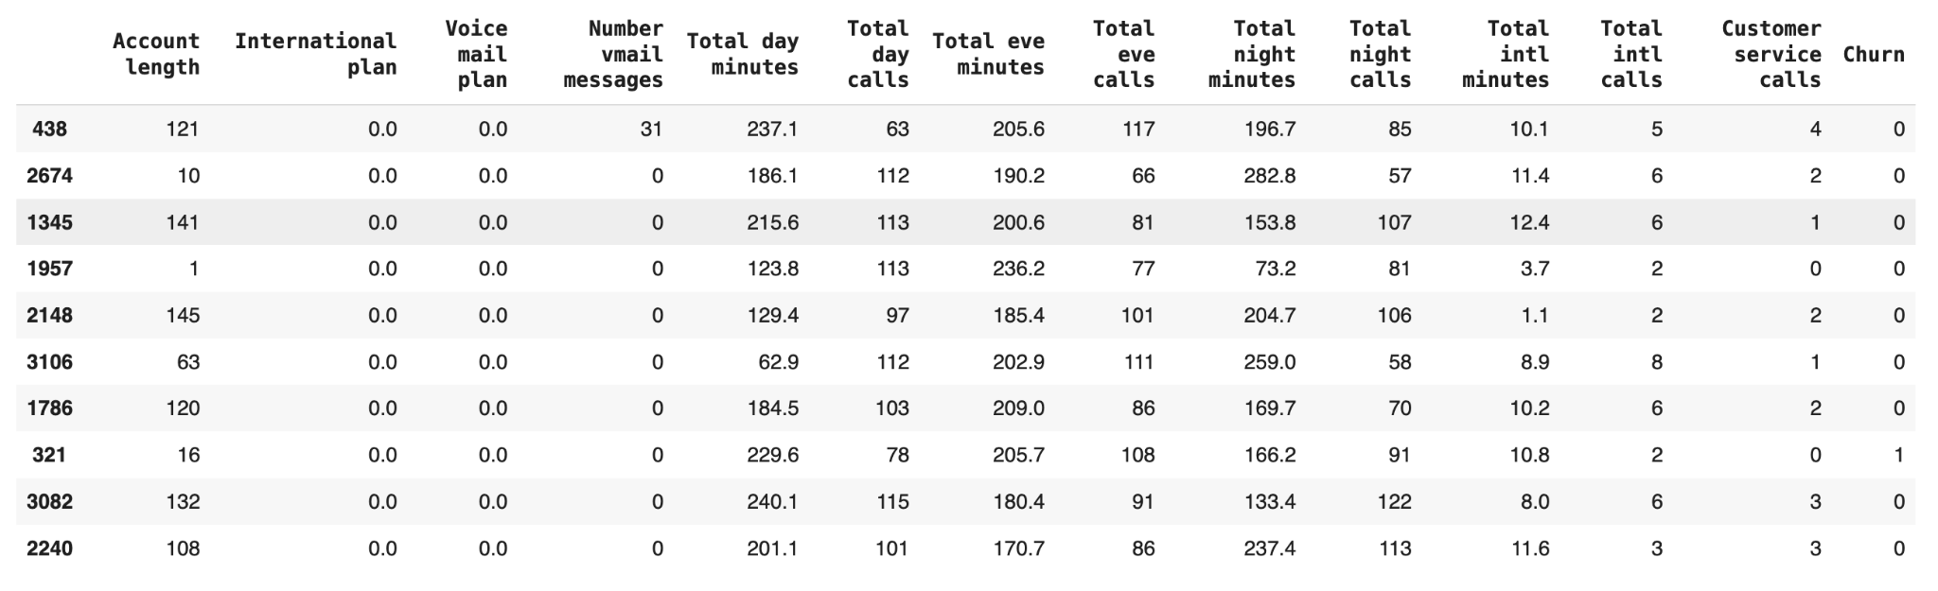
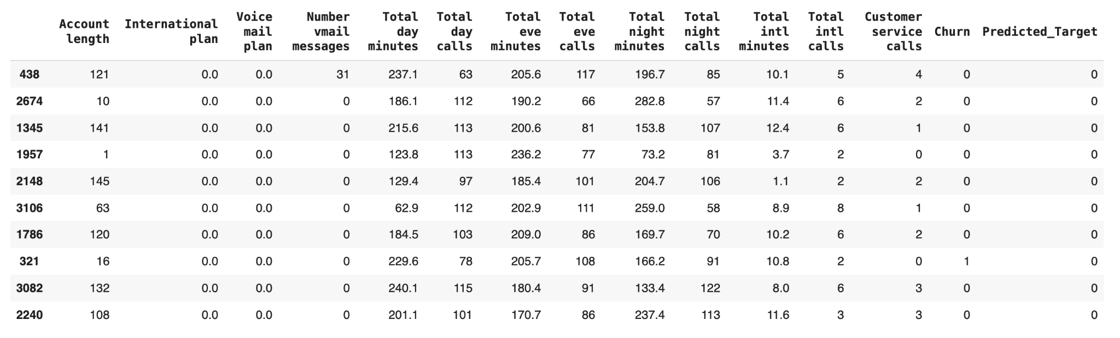
Identification of data source
Data cleaning & pre-processing
Model Training
Output Analysis
Prediction
Let’s predict fraudulent transaction with below data using the trained random forest model
In the predicted results, we observe that a transaction initially classified as fraudulent is now being identified by the model as a legitimate transaction.

Slide 11
Analysis of predicted result
It’s observed that one record was initially marked as a fraudulent, however let’s look few features closely:
Account length 16.0
Total day minutes 229.6
Customer service calls 0.0
These are some features that are considered when checking for Churn. These features are reasons why the eight row was predicted to be not churned. The Account length is at 16 days which indicates that the account has been opened for a short amount of time. The total day minutes is moderately high which indicates a decent amount of usage. The customer service calls column show that no customer service calls were made which indicate that the customer didn’t need much support or have issues that were discussed. These are some major factors that are considered when checking for Churn and all these point to a strong indication of non churned activity.

Slide 12
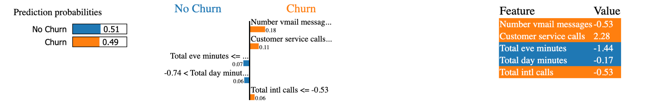
Explainable AI
Explainable AI is used to show how models make predictions and how the models are affected by the training data
The output of explainable ai in the chart on the left shows that in the probability prediction that there is a 51% probability that the output will be no churn and a 49% probability that it will be churn, showing a balanced dataset. The middle chart shows the important features with the bounding values. The chart of the right shows the features with their feature values.

Slide 13


Thank You !!
Chakrika Vemireddy

